Slide 1
SATELLITE IMAGE ANALYSIS FOR URBAN EXPANSION DETECTION
A. Jahnavi Dhana Sri

Slide 2
ABSTRACT
Motto of the Project: To analyze data for detecting , visualizing and predicting future urbanization changes using satellite images and big data technologies.
New Approaches:
Introducing a multi-index analysis combining NDVI,NDBI,MNDWI,BAEI and UI for enhanced accuracy in detecting urbanization changes for more accuracy.
We will employ various ML algorithms including K-Means Clustering, Convolutional Neural Networks (CNN), and Time Series Analysis to enhance the accuracy and depth of urbanization detection from satellite images.
To deliver precise and actionable insights, we used rasterio,earthpy, prophet and also used Matplotlib and Seaborn for detailed plots, and Tableau for interactive visualizations.
Predicting future urbanization change by analyzing present and past data.

Slide 3
MODULES:
DATA COLLECTION
DATA PRE-PROCESSING
DATA ANALYSIS
CHANGE DETECTION
VISUALIZATION
FUTURE PREDICTION

Slide 4
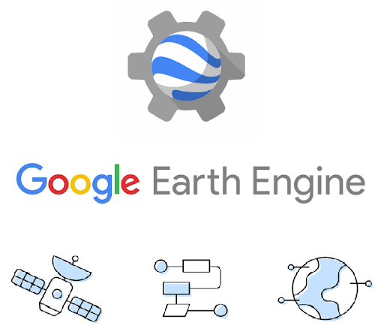

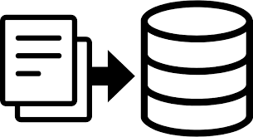
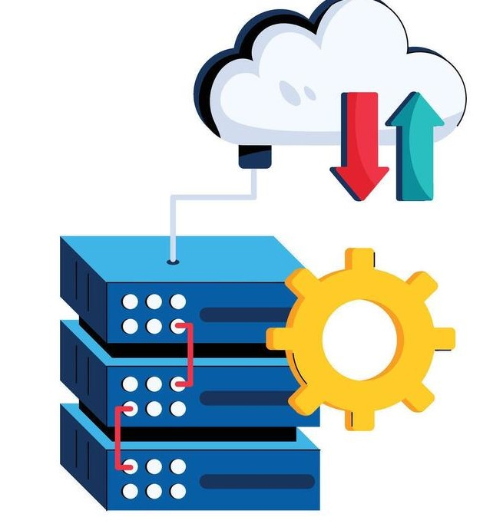
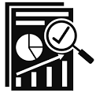
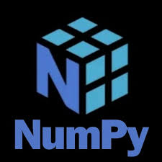

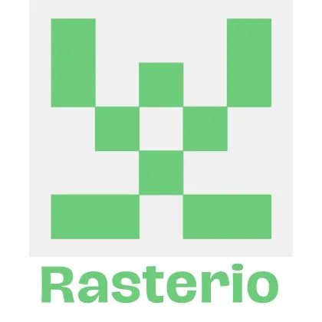
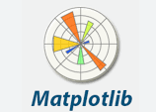

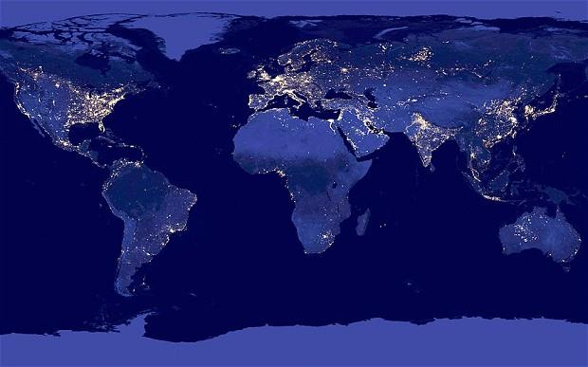

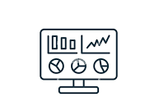
Data Collection and Storage
Data Pre-Processing
Data Analysis
To Get Required Satellite Images
Time series Forecasting
Urban Area Expansion Detection And Future Prediction Of Urban Expansion Area
Comparing the previous and present values using python.
Change Detection
Visualization

Slide 5
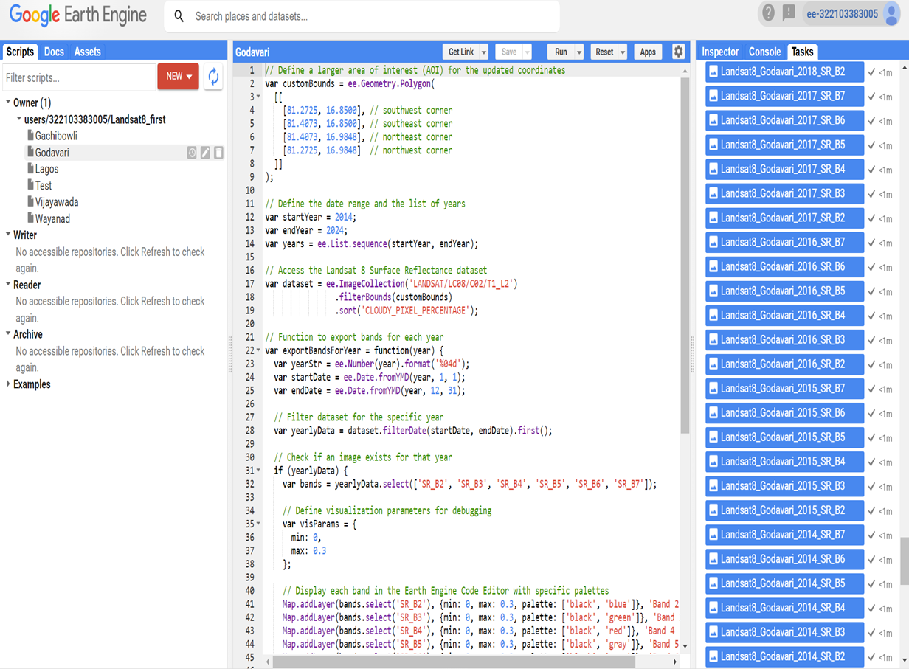
DATA COLLECTION
Landsat 8 Surface Reflectance
satellite images with 30m resolution.
Data size collected is 325.7MB
Important features from metadata:
Spectral Bands Info:
NDVI: Band 4 (Red) and Band 5 (NIR).
NDBI: Band 5 (NIR) and Band 6 (SWIR 1).
MNDWI: Band 3(Green) and Band 6(SWIR 1)
BAEI: Band 4 (Red) and Band 5 (NIR)
UI : Band 4 (Red) and Band 6 (SWIR 1)

Slide 6
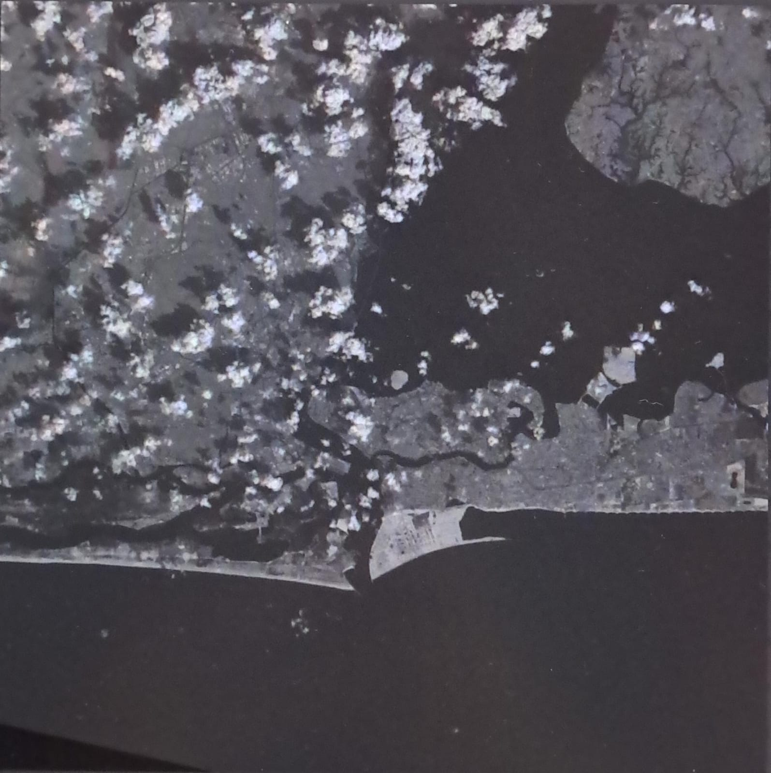
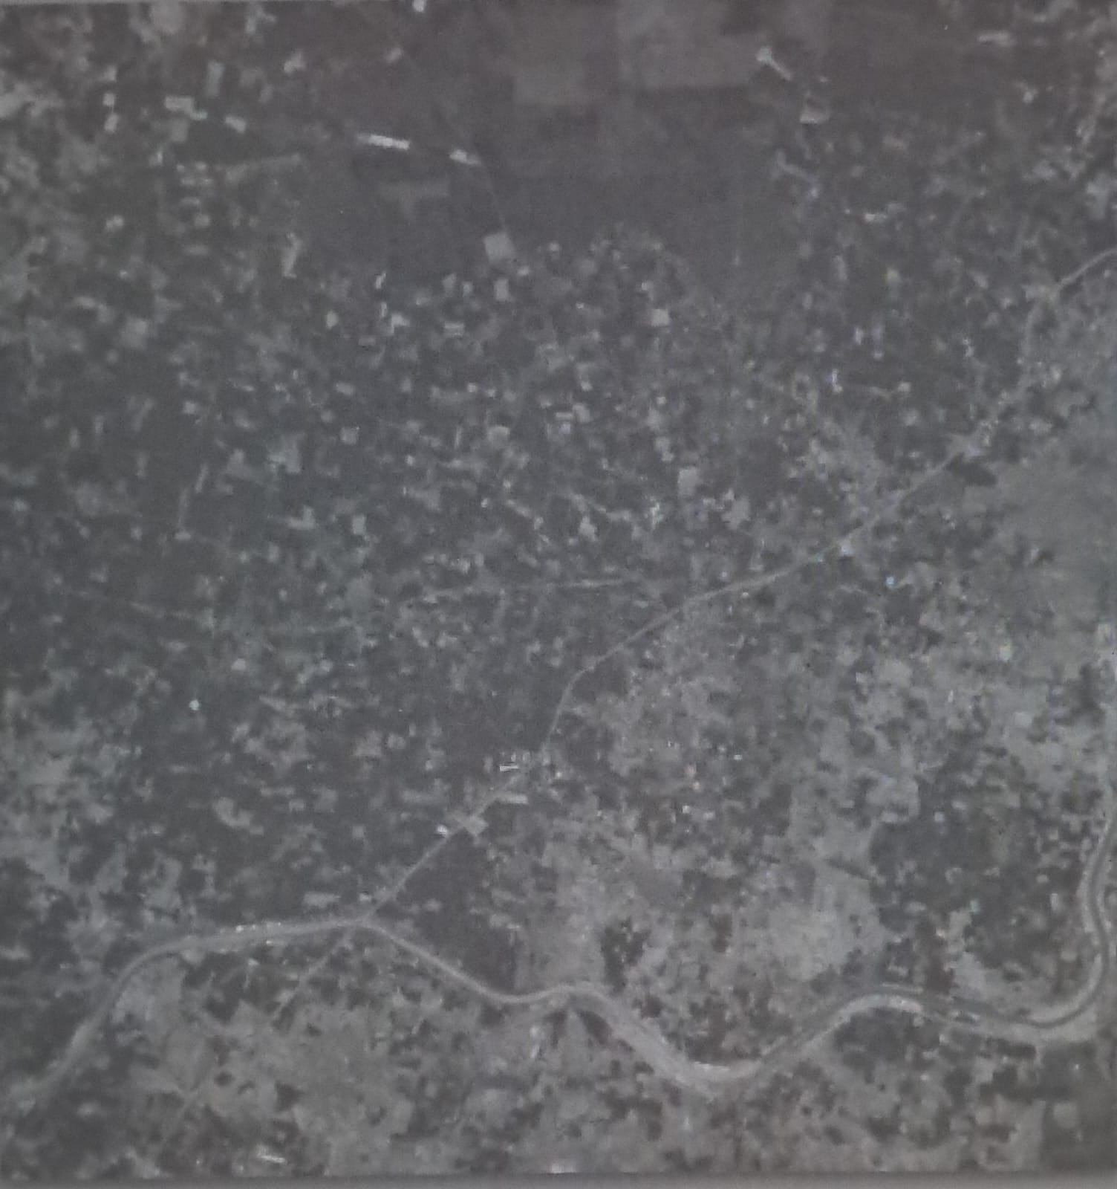
Lagos 2017 Band 7
Godavari 2022 Band 4

Slide 7
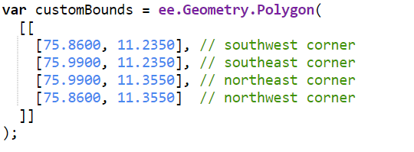
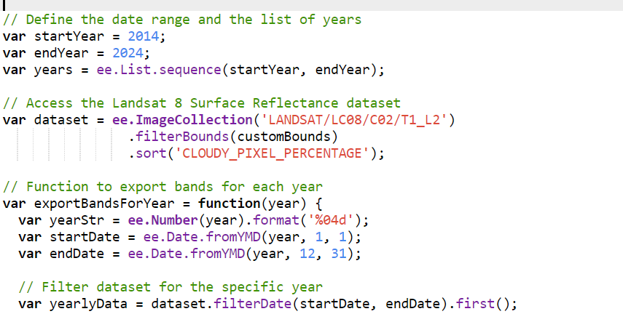
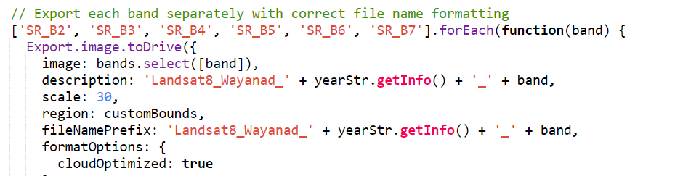
DATA PRE-PROCESSING
Defining Area of Interest (AOI):
Specify the geographical region for analysis to focus on relevant data.
Filtering Data by Date and Region:
Narrow down the dataset to specific time periods and spatial areas of interest.
Selecting and Exporting Bands:
Select bands (e.g., Blue, Green, Red, NIR, SWIR) and export them
as TIFF files for each year.
Python Libraries used: numpy, matplotlib,seaborn,rasterio,earthpy,glob

Slide 8
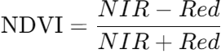
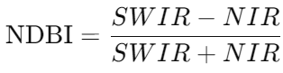
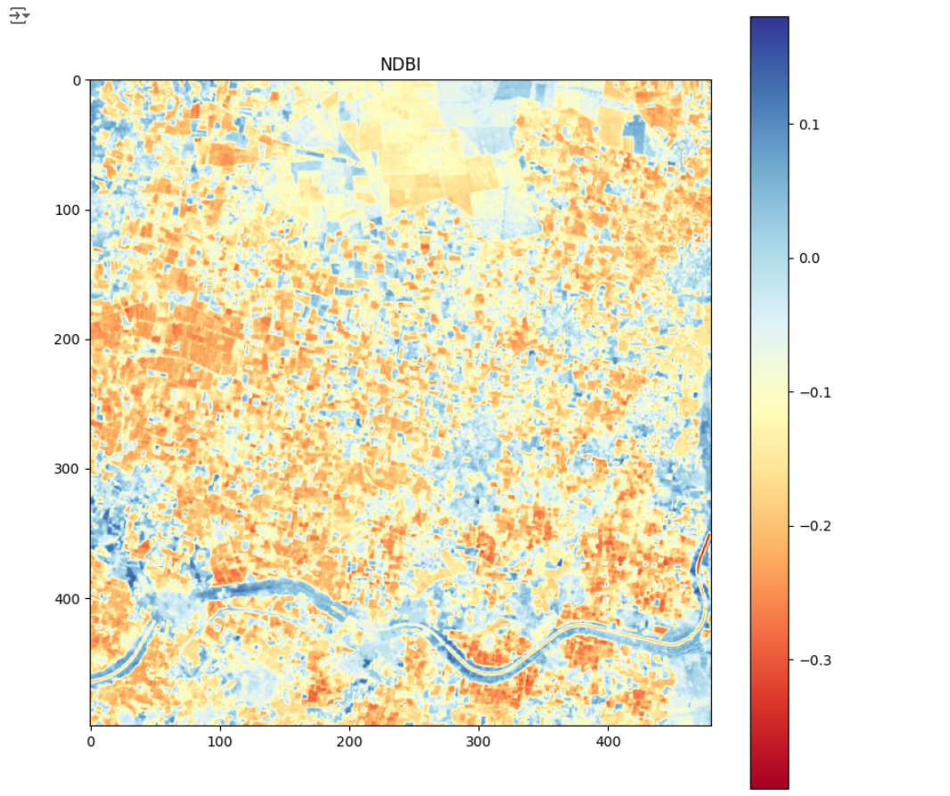
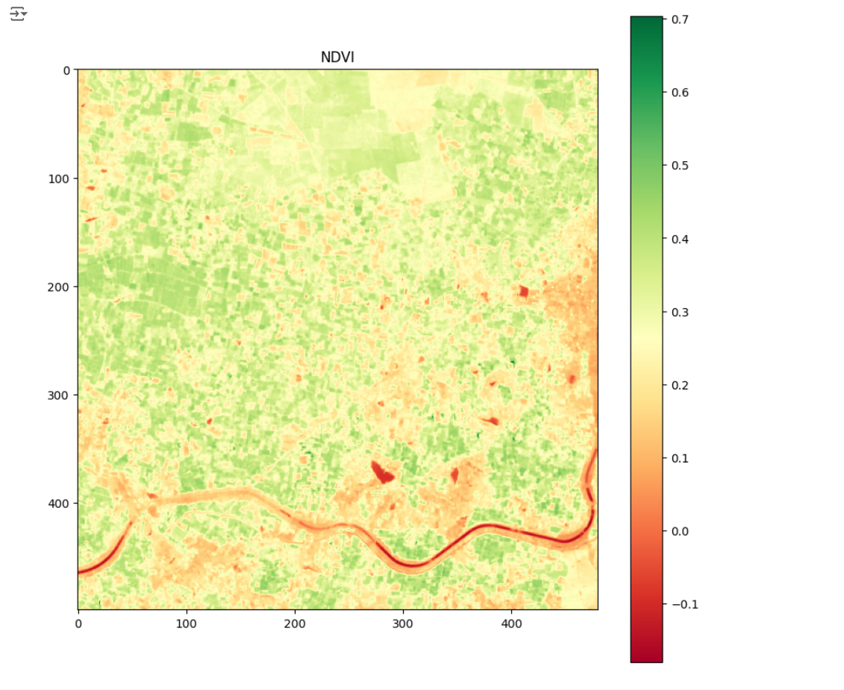
DATA ANALYSIS
NDVI (Normalized Difference Vegetation Index):
Use: Measures vegetation health.
Values:
High (0.2 to 0.9): Healthy vegetation.
Low (0 to 0.2): Sparse vegetation.
Negative: Non-vegetated areas.
NDBI (Normalized Difference Built-up Index):
Use: Identifies urban areas.
Values:
High (0.2 to 0.8): Urban areas.
Low (0 to -0.2): Non-urban areas.

Slide 9
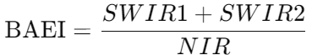
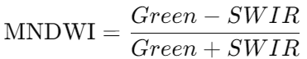
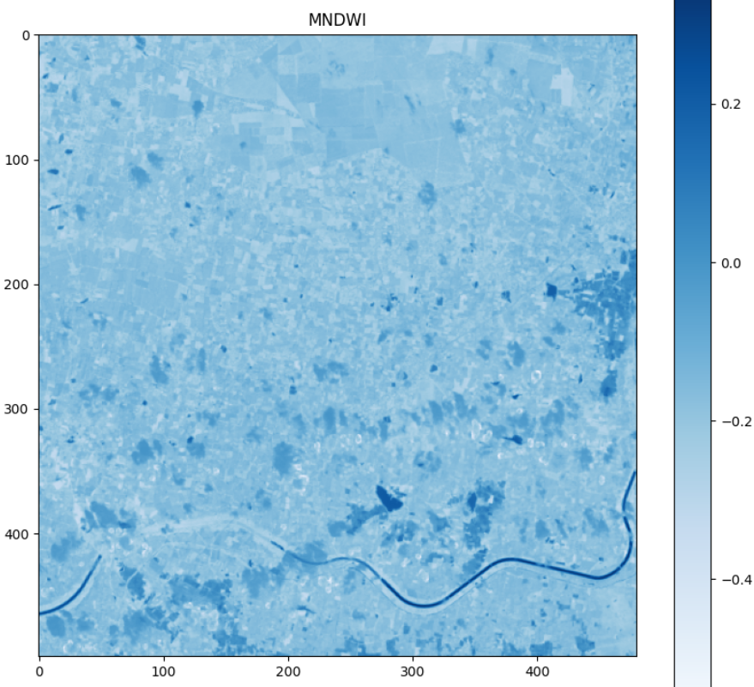
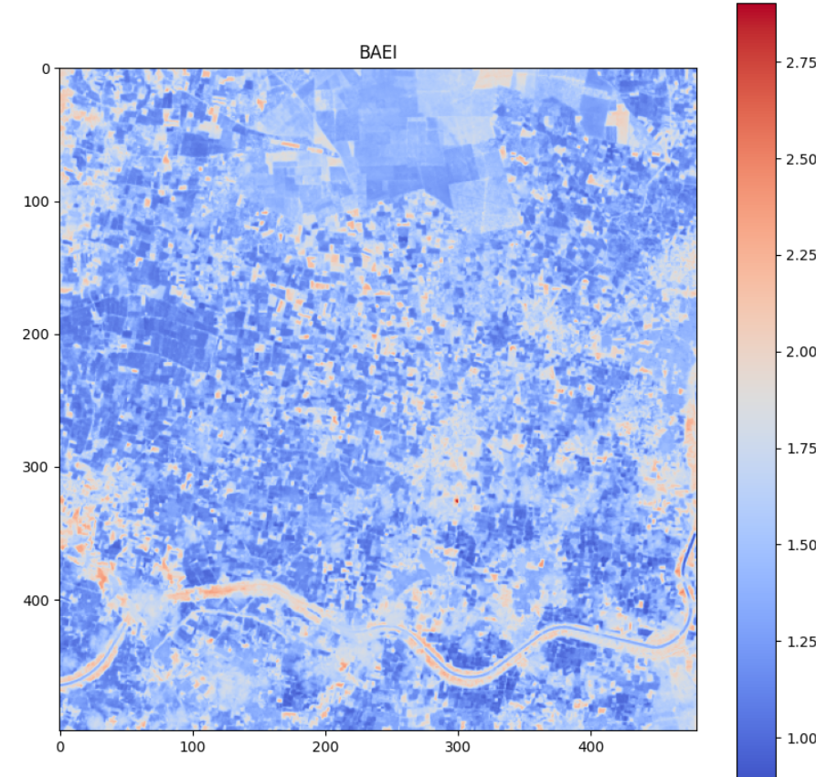
MNDWI (Modified Normalized Difference Water Index):
Use: Detects water bodies.
Values:
High (0.2 to 0.9): Water bodies.
Low (0 to -0.2): Land.
BAEI (Bare Earth Index):
Use: Identifies bare soil or rock.
Values:
High: Bare earth.
Low: Vegetation or urban areas.

Slide 10
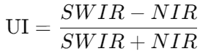
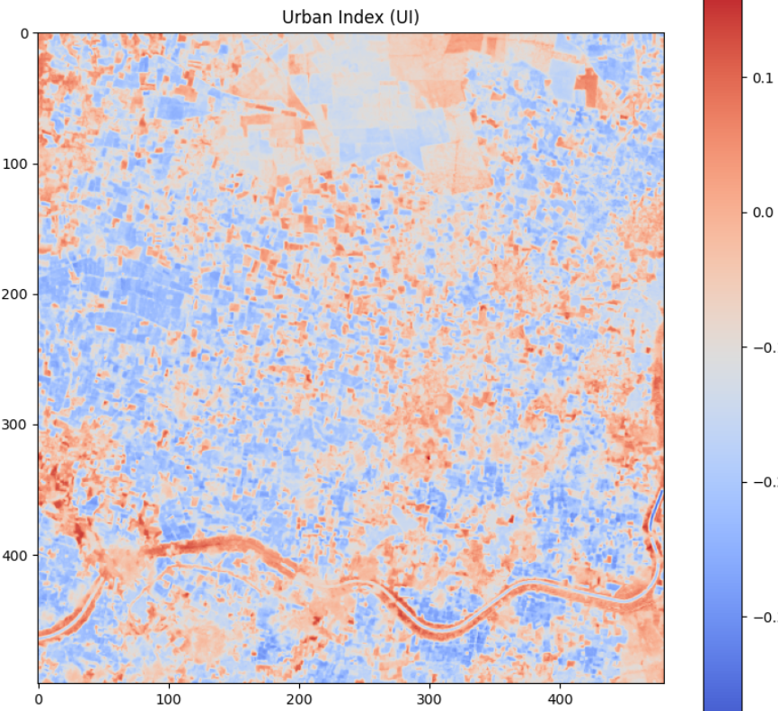
UI (Urban Index):
Use: Detects urban areas.
Values:
High (0.2 to 0.8): Urban areas.
Low (0 to -0.2): Non-urban areas.

Slide 11
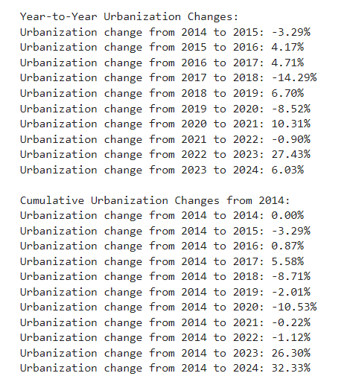
CHANGE DETECTION
Compute the NDVI, NDBI, MNDWI, BAEI, and UI indices for each year.
We are calculating the urbanization change from 2014 to 2024.
Use K-Means clustering (Data Stacking) to classify pixels as urban or non-urban.
Calculate year-to-year urbanization change and change from the base year (2014).
Godavari Region:

Slide 12
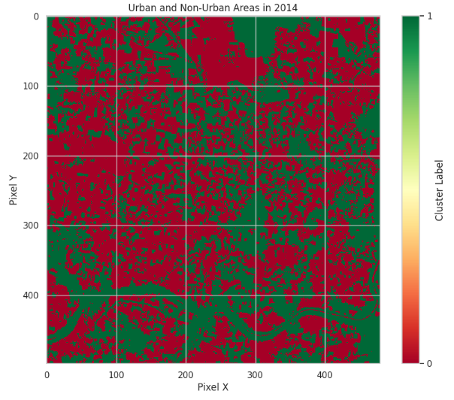
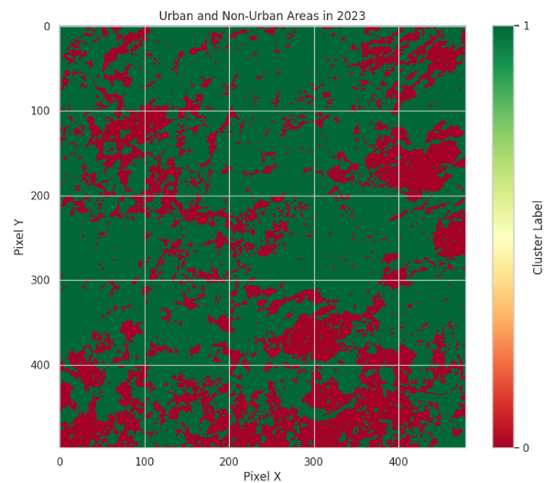

Slide 13
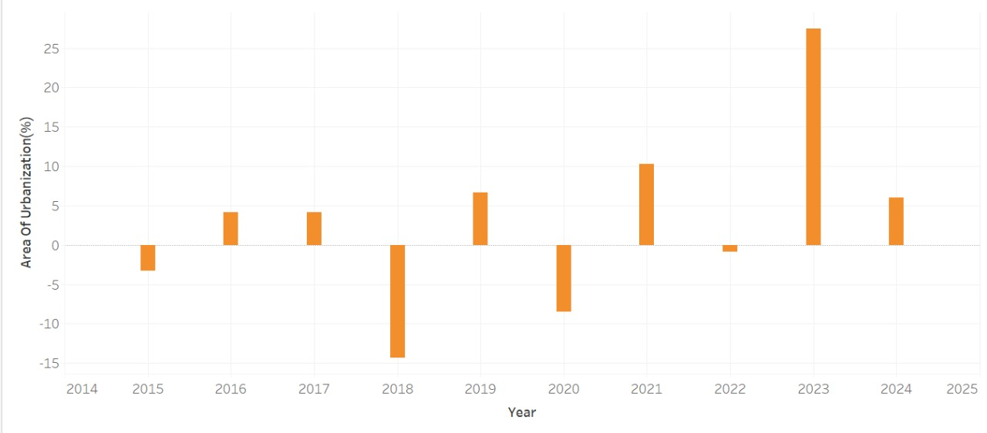
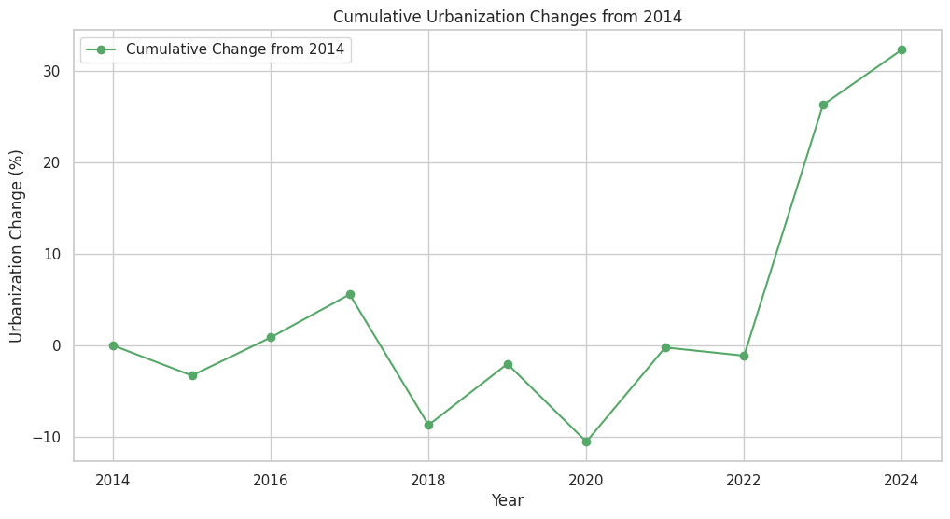
VISUALIZATION:
Visualization using Tableau: (Year to Year)
Visualization using Matplotlib: (Base year to Every year)

Slide 14
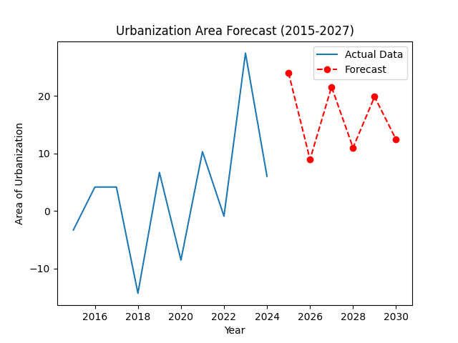
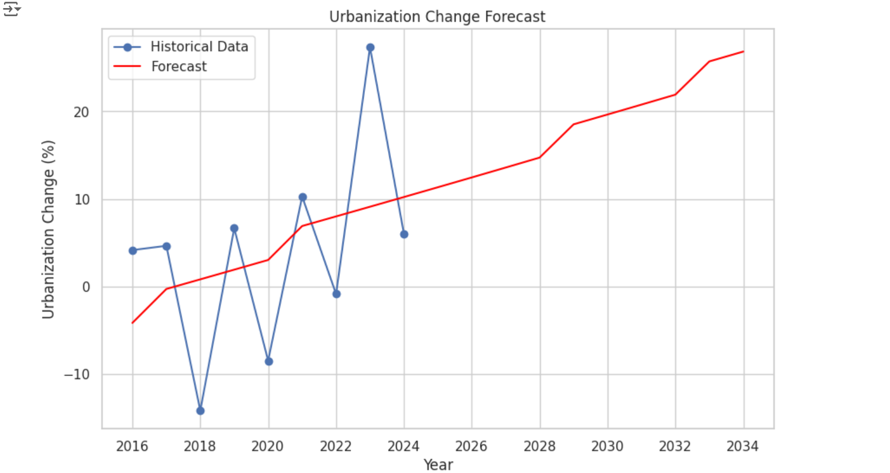
FUTURE PREDICTION:
TIME SERIES FORECASTING:

Slide 15
USE OF THE PROJECT
Urban Growth Insights: Identifies significant changes in urban areas, aiding city planners and policymakers.
Land Use Changes: Tracking changes for biodiversity conservation and sustainable land management.
Environmental Impact Monitoring: Helps monitor environmental impacts and identify areas of rapid urbanization.
Infrastructure Planning: Supports planning infrastructure and strategic urban growth.
Conservation Efforts: Highlights regions where urban expansion encroaches on natural habitats, promoting balanced and eco-friendly planning.

